Slide 1
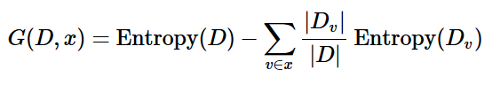
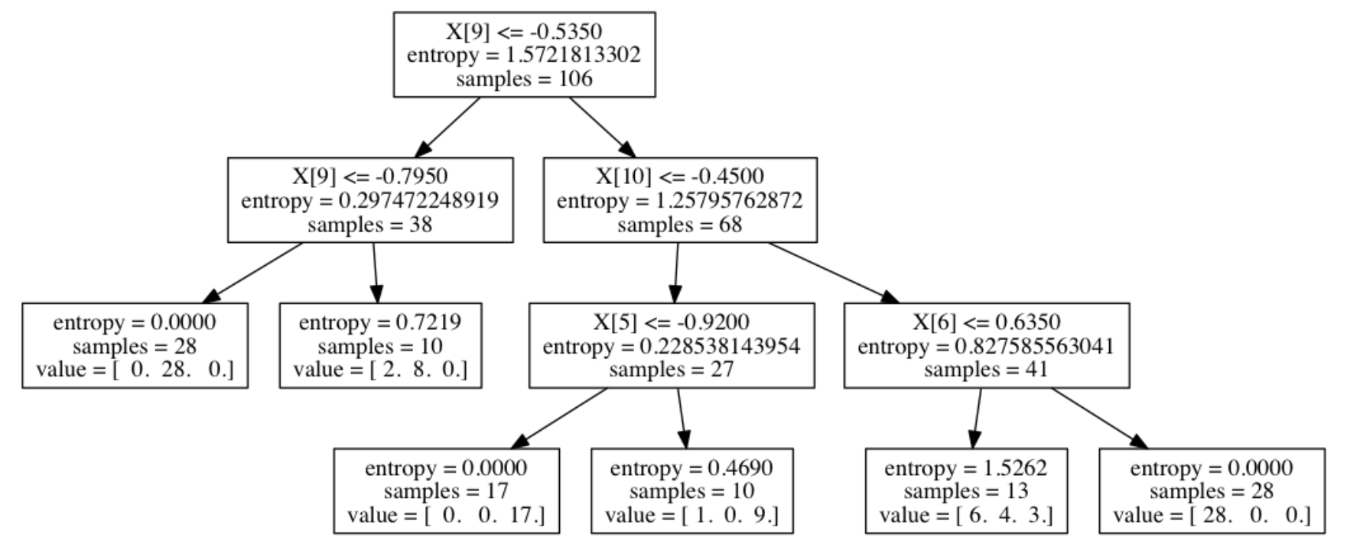

decision tree models
Machine Learning Methods for Biomedical Data (D012554)

Slide 2
decision tree models
advantages:
ease of interpretation
handles continuous and discrete features
invariant to monotone transformation of features
variable selection automated
low bias (deep trees)
disadvantages:
high variance
overfitting
Machine Learning Methods for Biomedical Data (D012554)

Slide 3
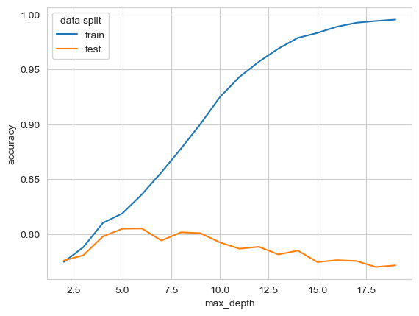
model selection
Machine Learning Methods for Biomedical Data (D012554)

Slide 4
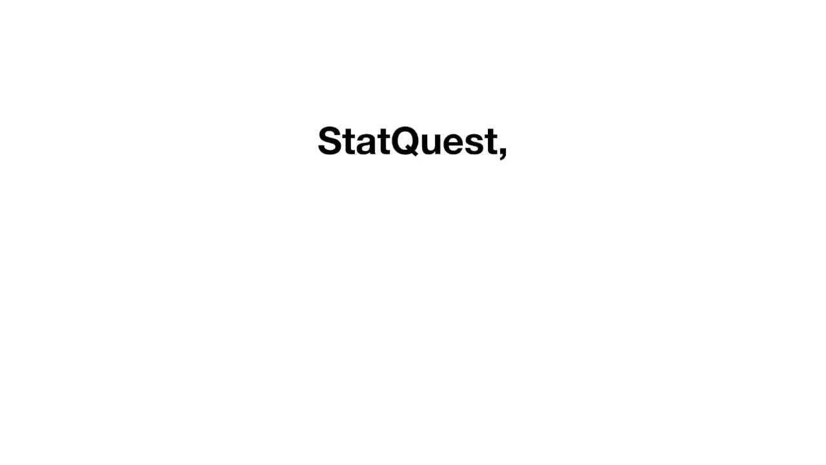
k-fold cross-validation
https://www.youtube.com/@statquest
Machine Learning Methods for Biomedical Data (D012554)

Slide 5

5-fold cross-validation
Machine Learning Methods for Biomedical Data (D012554)

Slide 6
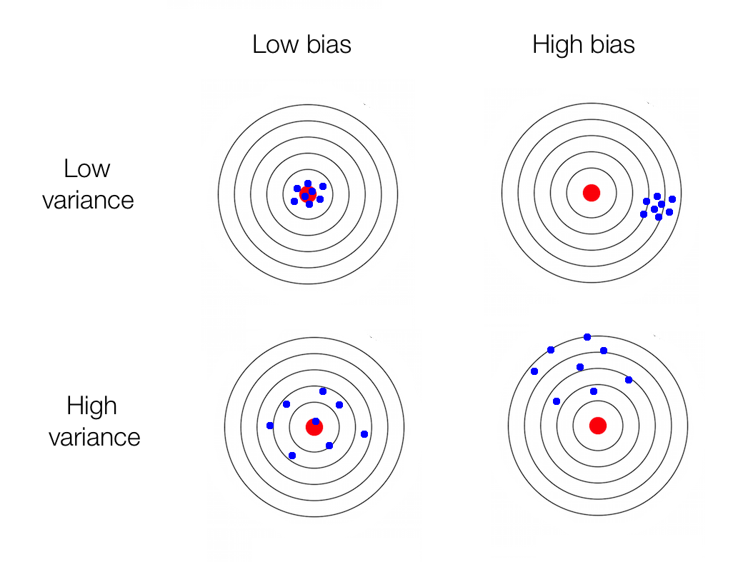
bias <> variance
Error due to bias
Error due to variance
Irreducible error
Machine Learning Methods for Biomedical Data (D012554)

Slide 7

bias <> variance
Error due to bias
Error due to variance
Irreducible error
Machine Learning Methods for Biomedical Data (D012554)

Slide 8
bagging <> boosting
boosting
bagging
Machine Learning Methods for Biomedical Data (D012554)

Slide 9
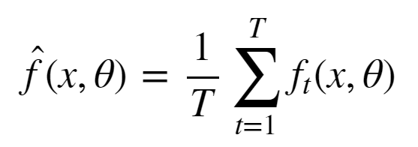
bagging
Simulate the notion of different train set samples:
sample data points from train set to create new train set
fit low bias high variance model on new train set
repeat steps (1) and (2) T times
average the predictions of the T models
Machine Learning Methods for Biomedical Data (D012554)

Slide 10
bagging: Random Forest
Train set contains n data points with m features.
Construct T low bias high variance decision trees by following these steps:
Sample n data points at random with replacement from the train set.
At each node, select h<<m features at random and compute the best split using only these h features.
Each tree is grown to the largest extent possible. There is no pruning or early stopping.
Step 3 ensures that the bagged models are low bias by learning deep complex decision trees.
Machine Learning Methods for Biomedical Data (D012554)

Slide 11
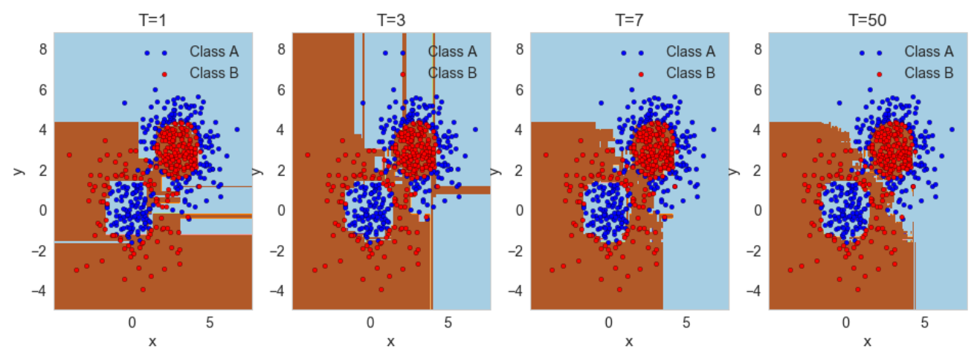
bagging: Random Forest
Machine Learning Methods for Biomedical Data (D012554)

Slide 12
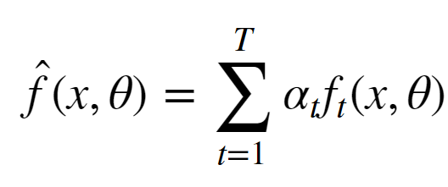
boosting
reduce the bias of a high bias low variance model
turning an ensemble of weak learners into a strong learner
the meta-model is additive, i.e. Adaboost:
Machine Learning Methods for Biomedical Data (D012554)

Slide 13
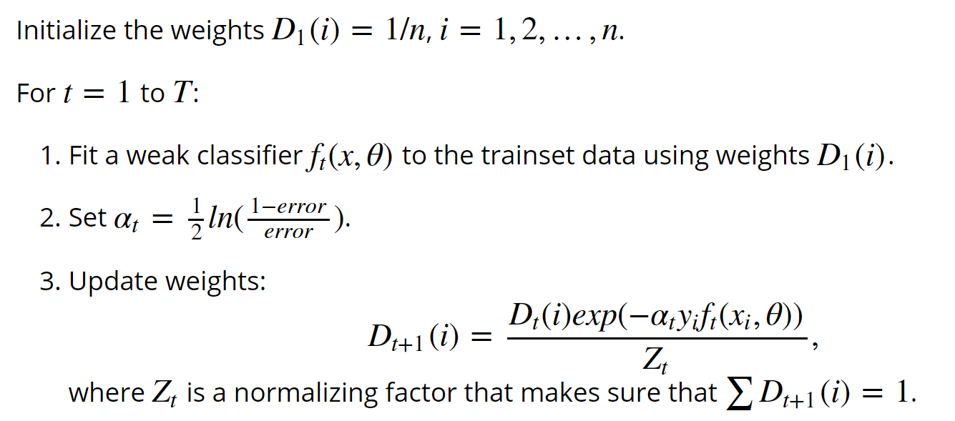
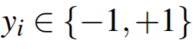
boosting: Adaboost
Machine Learning Methods for Biomedical Data (D012554)

Slide 14
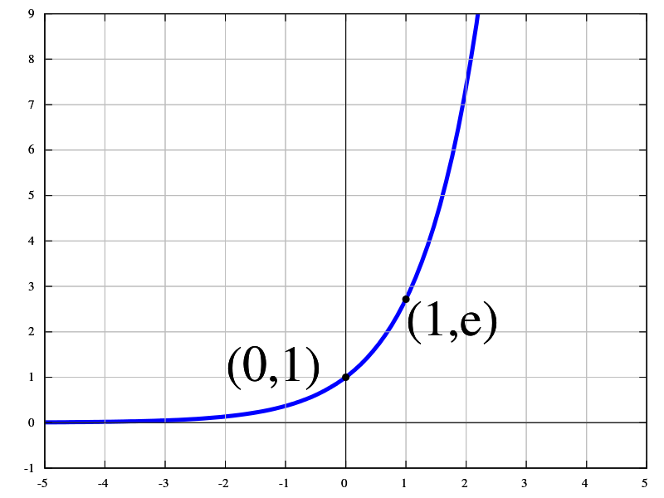
boosting: Adaboost
Machine Learning Methods for Biomedical Data (D012554)

Slide 15
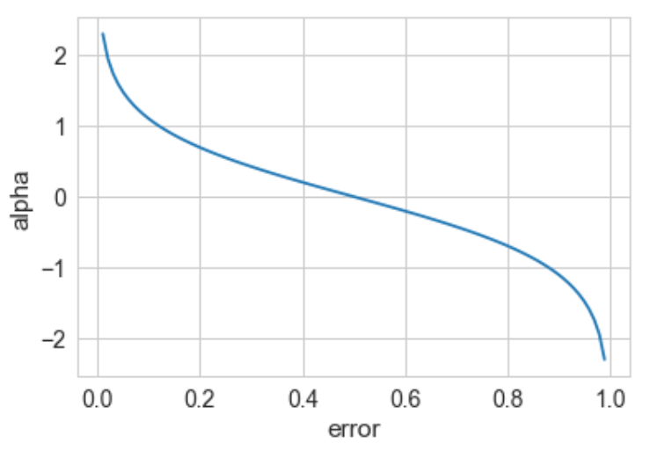
boosting: Adaboost
The weight of a weak model in the boosted meta-model increases exponentially as the error approaches 0. Better models are given exponentially more weight.
The weight is zero if the error rate is 0.5. A model with 50% accuracy is no better than random guessing, so it is ignored.
The weight decreases exponentially as the error approaches 1. A negative weight is given to classifiers with worse than 50% accuracy. “Whatever that classifier says, do the opposite!”.
Machine Learning Methods for Biomedical Data (D012554)

Slide 16
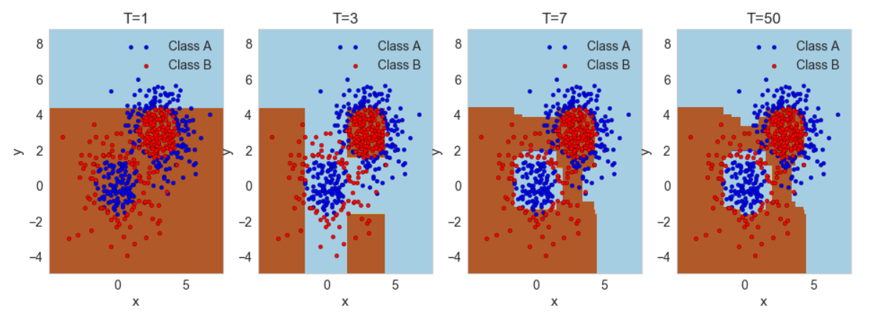
boosting: Adaboost
Machine Learning Methods for Biomedical Data (D012554)

Slide 17
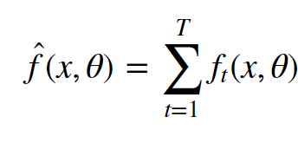
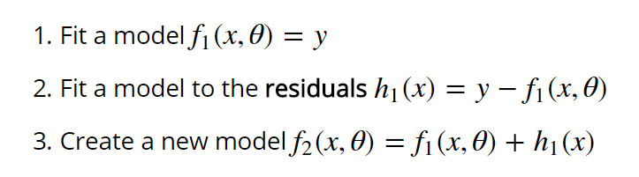
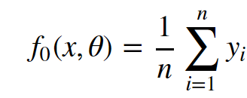
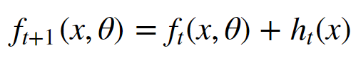
boosting: Gradient boosting
Machine Learning Methods for Biomedical Data (D012554)

Slide 18
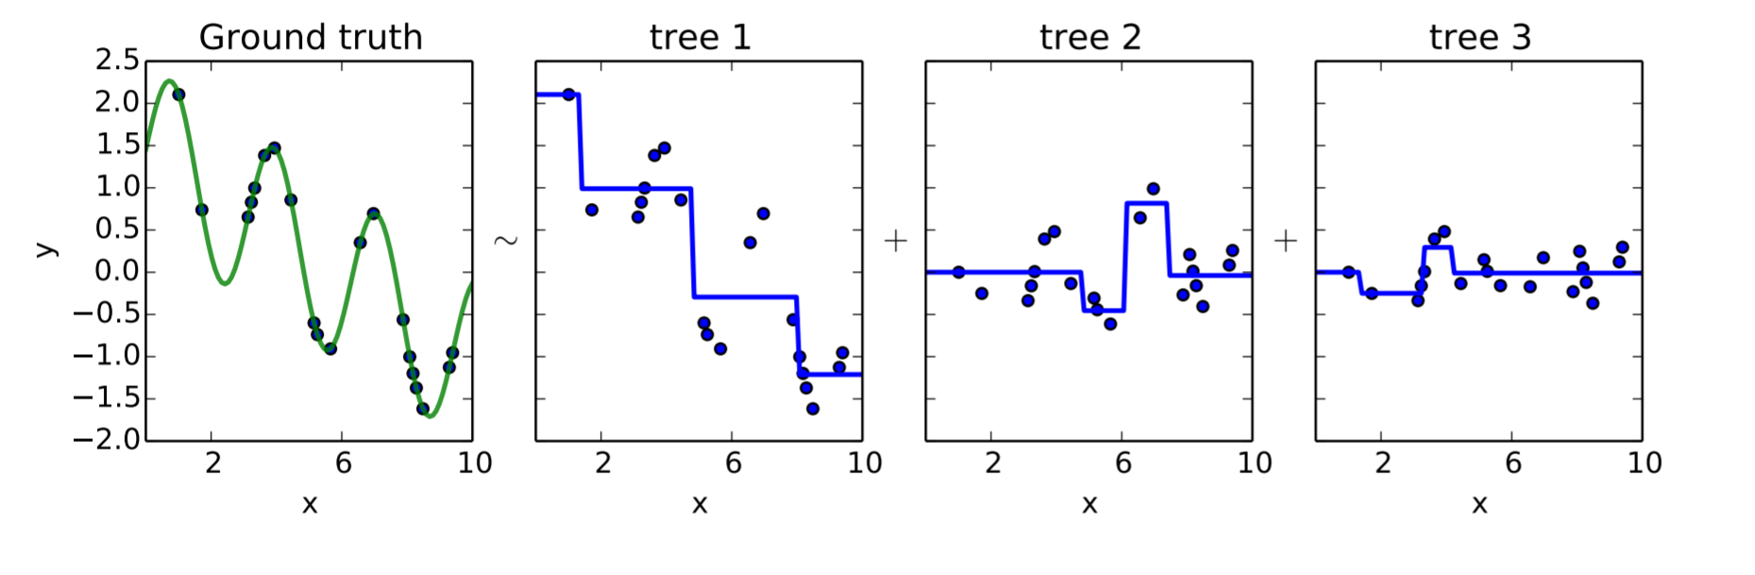
boosting: Gradient boosting
Machine Learning Methods for Biomedical Data (D012554)

